Slide 1

Green Pace
Security Policy Presentation
Developer: [Dustin Jackson]

Slide 2

OVERVIEW: DEFENSE IN DEPTH
Secure coding should have a solid blueprint and this model shows detailed methods of defense that the industry uses.

Slide 3
THREATS MATRIX
Different levels of vulnerability when it comes to standards in the industry and this charts helps understand this.
Likely Threats that will most likely happen | Priority Standard with high relevancy
Low priority Low relevancy | Unlikely Threats that will not happan

Slide 4
10 PRINCIPLES
• 1. Validate Input Data
• 2. Heed Compiler Warnings
• 3. Architect and Design for Security Policies.
• 4. Keep it Simple
• 5. Default Deny
• 6. Adhere to the Principle of Least Privilege
• 7. Sanitize Data Sent to Other Systems
• 8. Practice Defense in Depth
• 9. Use Effective Quality Assurance Techniques
• 10. Adopt a Secure Coding Standard

Slide 5
CODING STANDARDS
[List the 10 coding standards. Explain your own ranking system for vulnerabilities, using specific details from the coding standards in your security policy.]
1. Enumeration values should not be out of range.
2. Elements of a container, references, and pointers should be used correctly.
3. A null pointer should not be created from a STD:: string.
4. An owned pointer and unrelated smart pointer should not be stored within each other.
5. Allocated resources should be properly deallocate.
6. Static assertion should be used to test a constant expression.
7. exceptions should be handled before the main() code.
8. Positioning call should should be in respects to the input and output.
9. Constructors and destructors should not be invoked by virtual functions.
10. Returned functions at the exit paths should return a value.

Slide 6
ENCRYPTION POLICIES
Encryption in rest | Converting one data to another happens in the encryption in rest process. The algorithm that is used in this step is only authorized by a user who is qualified. Sensitive data is stored and must be secure properly on the severs and systems. This helps from breaches and attacks.
Encryption at flight | Encrypting data that is being transmitted is important to protect data. Data will not only be transferred internally but externally as well, and that needs to be monitored as well, so that there is no loop holes while sending data. This makes data vulnerable letting users send data so this encryption process must be completed before sending.
Encryption in use | This means to never leave data in an unsecure state. The data should always be encrypted regardless of the location and source. Data that is encrypted will stay secure and harder for hackers to attack the server.

Slide 7
TRIPLE-A POLICIES
Triple-A Policies
Authentication | This method is to make sure the users have access to the data that they are qualified to access in the server. A unique set of credentials are needed to access certain information.
Authorization | Profiles need permissions to change data, access information, and make system changes. Users only need to be able to access the section in which they need to do their job.
Accounting | This is where the system and data should be monitored to ensure everything is operating smoothly. The levels of access is also monitored in this process and should be verified consistently to make sure each users has the correct level of access.

Slide 8
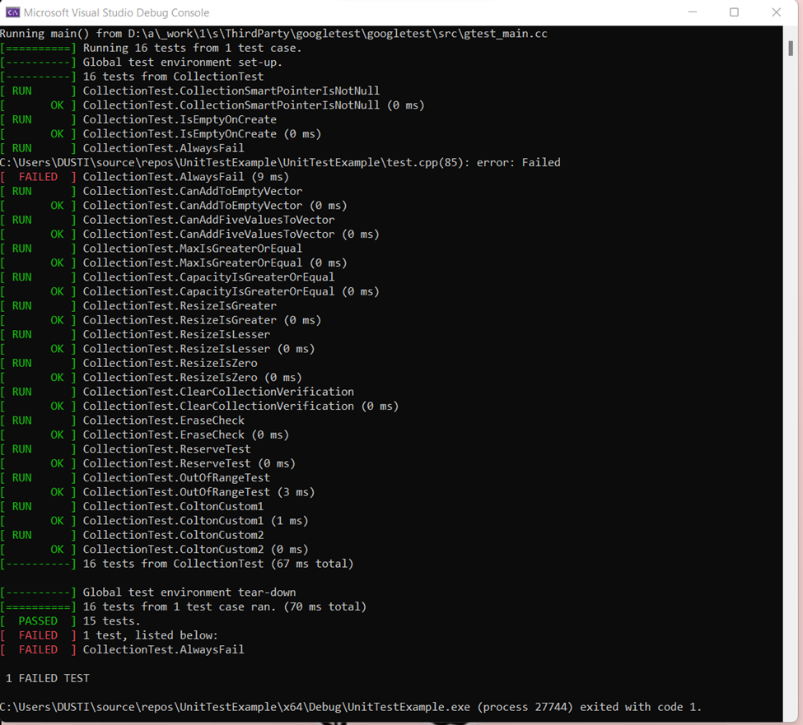
Unit Testing
Test should be done early in the process, and often as possible.

Slide 9

AUTOMATION SUMMARY

Slide 10
TOOLS
This is a method to perform secure coding and it should be used early in the process.
The diagram list almost list all the tools associated with the pipline. The maintain and stabilize section assess the security baseline which helps after a hacker attacks the database.

Slide 11
RISKS AND BENEFITS
Nothing will be 100% secure because the industry is consistently adapting new hackers and the risks stay the same even with more security being implied at these companies that have private user information. A solution would be to hire a department to study the latest threats in the industry and start working on ways to protect themselves.

Slide 12
RECOMMENDATIONS
Staying up to date with the latest threats are important to block hackers. Hackers are very cleaver and they will find loop holes around the security implemented in the code.

Slide 13
CONCLUSIONS
The standards I mentioned in this power point should be adapted in all practices and industries and they should be updated and worked on in order to continuously be able to protect the company from hackers.

Slide 14
REFERENCES
Seacord, R. (2020, November 18). Confluence. Retrieved from SEI External Wiki Home: https://wiki.sei.cmu.edu/confluence/

